Slide 1

Machine Learning – Certification Program (Aug 2018)
Code Assignment – Module 8 (SVM)
Phone : +91 9999658436
Offices : Bengaluru, New Delhi
Email : contact@cellstrat.com
Web : www.cellstrat.com
CellStrat™ Confidential. All Rights Reserved.

Slide 2
Module 8
Support Vector Machines

Slide 3
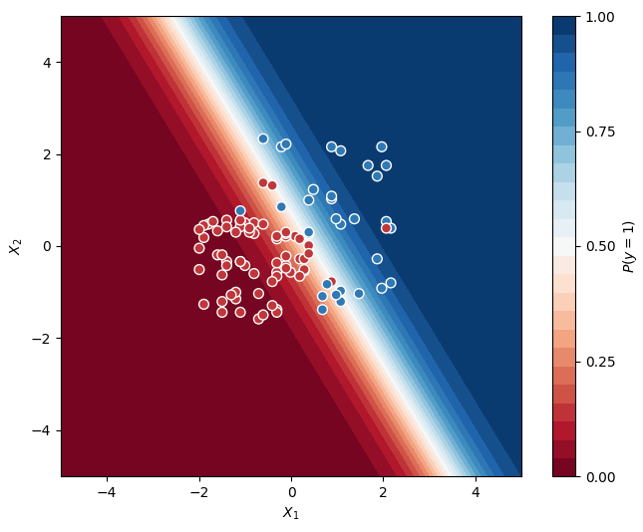

Questions
Classification – SVM filename : svm.ipynb
Tutorial name :- Predict whether consumers will buy houses or not, given their age and salary.
(using SVM)
Q1) Check the classification hyperplane which the program produces. Do you think a linear classifier is possible to segregate this set of data completely accurately ? Is the SVM classifier able to find a accurate classifier ? How do you rate SVM classifier performance here ?

Slide 4
Questions
Filename - SVM Classification.ipynb
Classification – Classification SVMs
Name - Classify IRIS dataset using SVM; demonstrate how Kernel SVMs can help classify non-linear data.
Q1) What is maximum margin hyperplane ? How do you find it ?

Slide 5
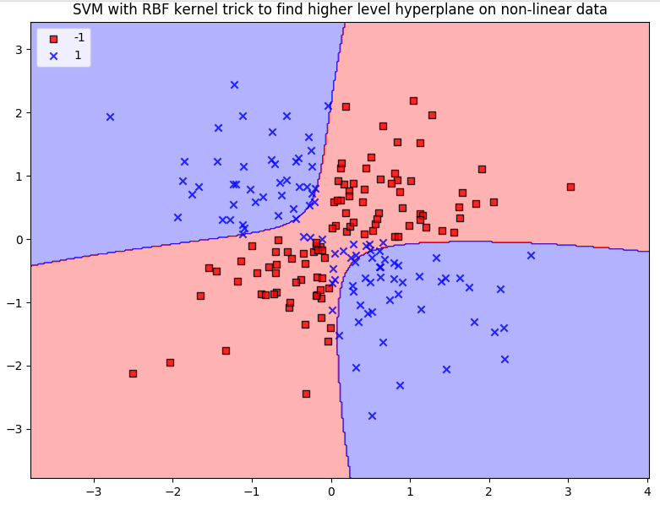
Questions
Filename - SVM Classification.ipynb
Q2) What is the name of the trick used in this program for classifying the XOR dataset. What does it do ?

Slide 6
Questions
Filename - SVM Classification.ipynb
Q3) What does gamma represent in a SVM class in this code (Cell 16) ? What happens when it is high and when it is low ?

Slide 7
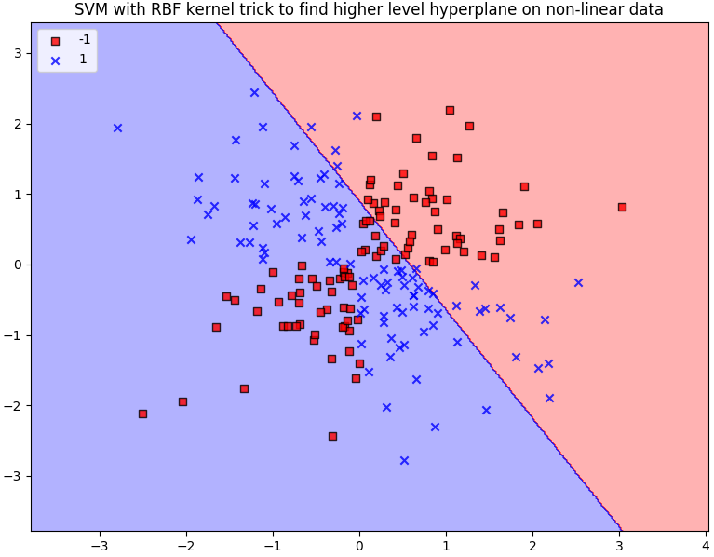
Questions
Filename - SVM Classification.ipynb
Q4) For the XOR data in this program, change the kernel trick from RBF to linear and check what kind of classifier gets produced. Interpret the data. (Cell 16)

Slide 8
Questions
Filename - SVM Classification.ipynb
Q5) For the Iris dataset, add new code at the end of this program to produce classification for RBF kernel trick with gamma = 1.0. Explain the output.

